Slide 1
Autonomous
Mini Blimp
Team 4:
Ben Vu, Dylan Filkins, Jacob Thomas, Nick Short, Victor Albarran, Zeming Zhou
Sponsor: Galois Advisor: Marek Perkowski
Notes:
Hello, this is team 4’s autonomous mini blimp project
Our sponsor is Golois and advisor is Dr. Perkowski
I’m Ben

Slide 3
What was the project?
飞艇将完全在室内、办公室环境中使用
The main purpose of the airship
The Blimp will be used entirely in indoor and office environments
The Blimp will perform the task of detecting and transmitting information
Since the airship needs to transmit information, it will need network connectivity and the ability to recognize objects.
Recognize voice information through microphone
Notes:
Zeming 1

Slide 4
Concept of Operations
Initial task
Create a mini-blimp with some autonomous controls
Is able to be manually controlled (similar to RC flight) by user
Now the task is to find simulation software that can validate blimp design
Test different blimp designs (Volume, Shape, # of propellers)
Simulate blimp performance
Be able to output speed and turning capabilities of blimp
Notes:
Original Concept of Operations
1 Concept of Operations
The purpose of this project is to design a proof of concept of a semi-autonomous blimp
that will fly around an office space which is our Minimum Viable Product (MVP). The
craft uses helium as its primary lift mechanism, the craft must be remotely operable by a
typical hobby controller, and all power sources, radios, sensor control systems are
subject to a weight restriction depending on the blimp helium and shape. Manual control
from a remote will allow the user six-degrees of freedom. Galois will use the final
designed blimp to be used in an office environment for various tasks and for a team
competition between blimps.
Ben 1
At the start, the idea was to create a mini-blimp with some autonomous controls
Which would be collision detection
But for the most part is user controlled with a hobby controller
That was a big promise and would prove to go beyond 2 terms
Now we revised the plan to use a simulation software to validate blimp design
The software will be able to test various designs (such as, size, shape, # of propellers)
And that will be used to simulate its performance
Then outputs its speed and turning capabilities

Slide 5
Initial Plan
The initial plan was to develop an autonomous blimp prototype for two scenarios (office use for Galois and DARPA competition).
The office environment would be to relay information and messages to employees.
The DARPA competition required the blimp to perform in a Quidditch like match to showcase capabilities
Considerations by Galois and DARPA would be considered for autonomous operating and outside influences (wind, image recognition, attacks, etc)
Notes:
Dylan: As mentioned earlier

Slide 6
Revised Plan
Due to COVID-19 impacts the scope of the project was changed to focus efforts on office use.
AI would be integrated later by the sponsor
Creating a physical prototype was determined to be unfeasible. Instead a computer simulation would be created
The simulation would model the behavior of a blimp to provide information about blimp dynamics
The simulation could then be used to help design a custom chassis
Notes:
Jacob 1

Slide 7
The Main Components of the Blimp
Envelope - It consists of a shell containing a gas less dense than air. The gas not only provides lift for the airship, but also provides a "structure" for the envelope to keep the shape of the shell unchanged.
Gondola - It is used to carry various electronic equipment and as the connection point of the engine. The gondola is the heaviest part of the airship, so the lightest materials must be selected to manufacture the gondola.
Notes:
zeming:

Slide 8
IP and Prior Work
suppressed
Notes:
Nick 1

Slide 9
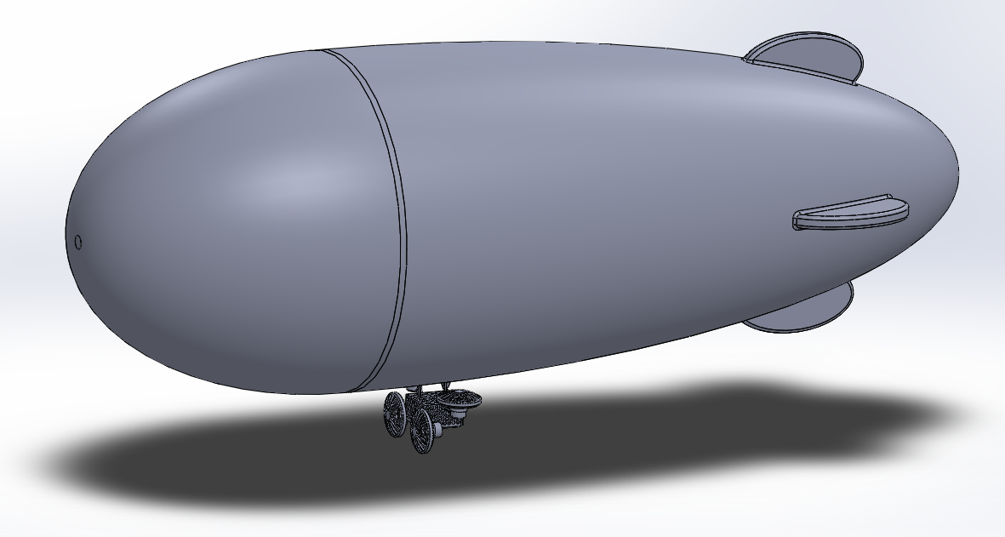
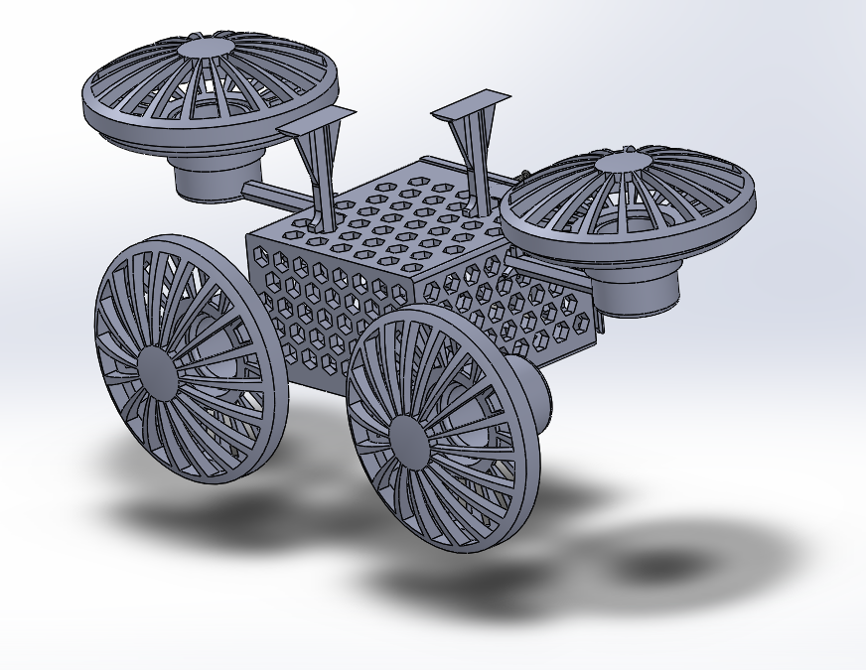
Diagram
Chassis Specifications:
~ 22 x 10 x 8.5 cm
80 grams without components
PLA
Chassis Considerations:
Airflow over electrical components
Shroud over propellers
Protection of electrical components
Modularity in propeller placement
Notes:
Dylan 2:
The diagram was an additional deliverable that was to be implemented along with the simulation. This was to allow concurrent development of the design and simulation. This allowed a proper efficiency of time and gain greater insight into the effect of the chassis design. So you can see the design in the full scale with a respective size of 1.4 m. If we look at the two photos below, we will see the chassis design that was design. As well as the exploded view of the design with all fasteners. The chassis design was further analyzed with the material properties and looking at the sponsor’s desires.

Slide 10


Overview of Software
Several softwares were considered for use
Each software was ranked based on features which were considered to be important
Physics Modeling
Ability to calculate path deviation
Ability to visualize simulation
Two softwares were chosen to create simulations:
Notes:
Jacob 2

Slide 11
Testing/Test Plans
Maneuverability
Maneuverability is the blimps ability to change position, direction, and speed.Blimp
Top Speed
Turning Radius
Acceleration
Total Mass
Buoyant Force
Power Draw
Notes:
Victor 1

Slide 12
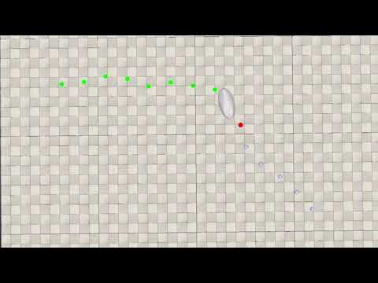
CoppelliaSim
Open source and multi-platform desktop application
Built-in library includes robots, sensors, and actuators.
Simulation scripts are natively written in LUA.
Remote API access via C++, Java, Python, Matlab, and LUA.
Several options for physics engines, including Bullet, ODE, Vortex, and Newton.
Runs on Windows, Linux and macOS.
Notes:
Nick 2

Slide 13
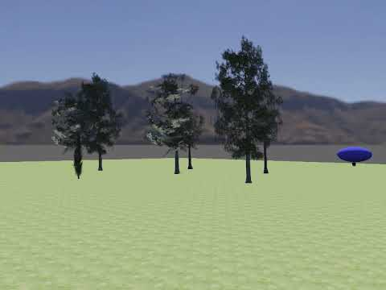
WeBots
Open source and multi-platform desktop application
Library includes robots, sensors, actuators, objects and materials.
Simple API and can be programmed in C, C++, Python, Java, MATLAB.
Modern GUI, a physics engine and an OpenGL 3.3 rendering engine.
Runs on Windows, Linux and macOS.
Webots Blimp Simulation
Notes:
Victor 2
Open source and multi-platform desktop application
Library includes robots, sensors, actuators, objects and materials.
Simple API and can be programmed in C, C++, Python, Java, MATLAB.
Modern GUI, a physics engine and an OpenGL 3.3 rendering engine.
Runs on Windows, Linux and MacOS

Slide 14
What was Achieved
Airship - The envelope design allows navigation through indoor environments.
Gondola - The gondola uses a lightweight perforated design so the air resistance is not significant and will not reduce the top speed of the blimp. This model also does not negatively affect the balance of the blimp.
Blimp Movement - We have theorized an optimal movement method but were not able to implement it into the simulation.
Notes:
Zeming 2

Slide 15


Post Mortem
Uncertain deliverables due to miscommunication which lead to poor use of time.
Team identified that project was falling behind schedule and requested assistance.
Team members had very little experience with simulations and had a difficult time transitioning to the new approach.
The simulation turned out to be an effective tool but would have been more successful if it had been the initial method.
Notes:
Ben 2
At the start, we were given a scope that was very broad
We narrowed down our scope by pursuing an experimental approach
This turned out to be the wrong direction
To correct this we redirected our project to pursue a digital simulation
However the team had little experience with the simulation software which made this transition difficult
Considering how effective the tool turned out to be, the team would have been more successful if this was the first approach

Slide 16
Contributions
Ben Vu - Documentation, SolidWorks, Github
Dylan Filkins - SolidWorks, Documentation
Jacob Thomas - Documentation, Simulation
Nick Short - Simulation, Documentation
Victor Albarran - Simulation, Github, Documentation
Zeming Zhou - Simulation, Documentation

Slide 17
Questions?

